Slide 1

Comparing Food Deserts: 2010 & 2019
Joe Wawrzaszek
Derry Li
Stephanie Coleman
K Agajanian

Slide 2





Overview
The Issue
Food Insecurity
Food Deserts
A Closer Look
Washington, DC
Conclusions
Recommendations
Future Research
Programs
SNAP, EBT,
WIC
Notes:
Table of Contents and Overview:
Defining the issue
Zooming in on DC
Assistance Programs
Findings and Conclusion
Contents
Overview & Problem
Scope & Process of Scoping Down
Methods
Results
Conclusions

Slide 3

“Food Insecurity” and “Food Desert” Defined
Food Insecurity is a household-level economic and social condition of limited or uncertain access to adequate food.
A Food Desert is a low-income census tract where a substantial number of residents do not have easy access to a supermarket or large grocery store.
Source: US Department of Agriculture

Slide 4
Food Deserts in the News: Buffalo
“The beloved Tops is the only supermarket in a one-mile radius within this largely Black neighborhood and one that took more than a decade to get.”
“The nearest grocery store is a Wegmans, which is about 4 miles away. Although it’s a 15-minute drive, public transportation could make the journey up to an hour long."
Source: CNN
Notes:
Table of Contents and Overview:
Defining the issue
Zooming in on DC
Assistance Programs
Findings and Conclusion
Contents
Overview & Problem
Scope & Process of Scoping Down
Methods
Results
Conclusions

Slide 5

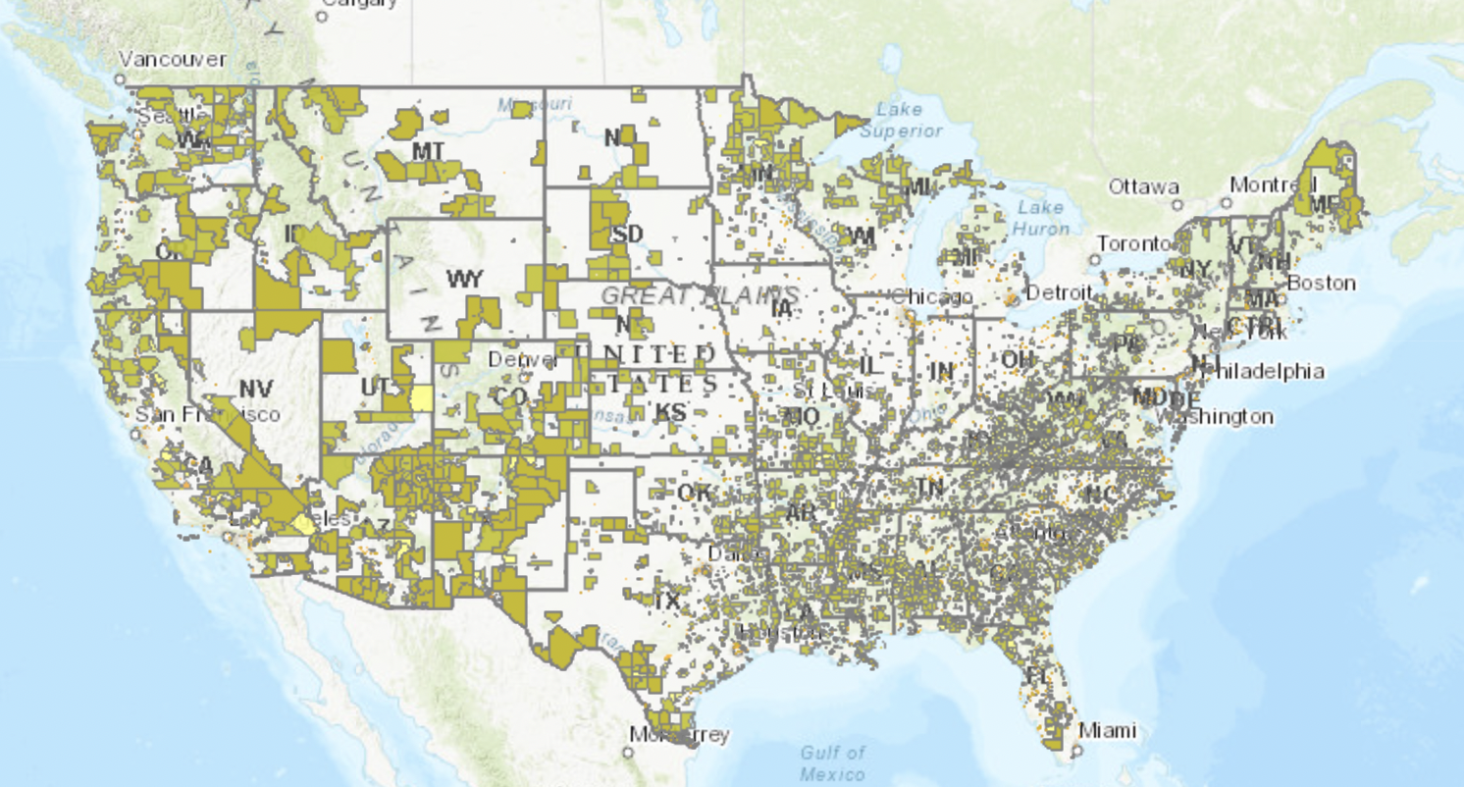
Food Insecurity and Food Deserts in the US
At least 13.5 million people in the US are food insecure.
Almost
1 in 5 households with children are food insecure.
USDA ERS - Go to the Atlas
Nearly 10% of census tracts (approximately 6,400 out of 70,000) are food deserts.
Notes:
Screenshot from USDA ERS - Go to the Atlas
We say “at least” because it is unclear how well these definitions capture the reality of Americans’ access to food.

Slide 6
Problem Statement
How did the Washington, DC food desert landscape change between 2010 - 2019 and what inferences can we draw?
Notes:
Table of Contents and Overview:
Defining the issue
Zooming in on DC
Assistance Programs
Findings and Conclusion
Contents
Overview & Problem
Scope & Process of Scoping Down
Methods
Results
Conclusions

Slide 7

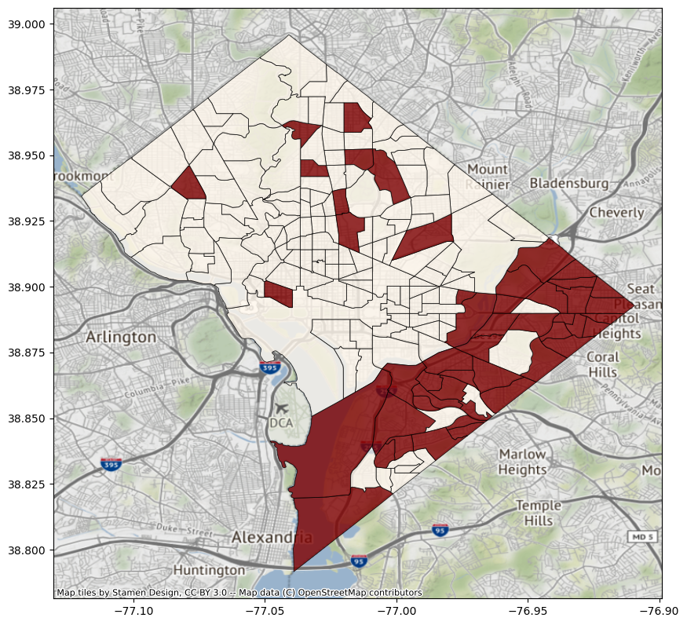
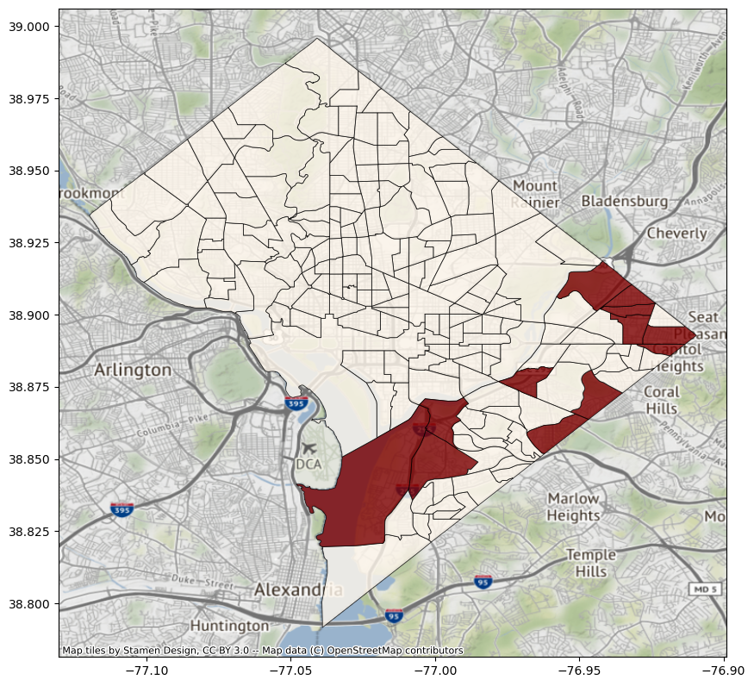
USDA Food Desert Main Categories
Defining low-income low-access (LiLa) census tracts
Poverty rate > 20%
> 0.5 miles to supermarket
Poverty rate > 20%
> 1 mile to supermarket

Slide 8

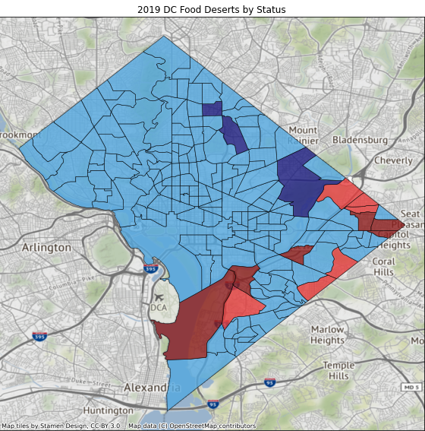
A Closer Look at D.C.
Washington, D.C.
Focus on 1 mile urban
Food Desert Status Engineering
2010 and 2019 Comparison
Became a Food Desert
Became Food Accessible
Remained a Food Desert
Remained Food Accessible
6
3
6
164
Notes:
Our Focus Explained:
Ex.
DC
1 mile urban, 10 miles rural
Food desert status 2010 and 2019 comparison
Explain status : remained or became..
Method Explained:
- including feature engineering

Slide 9

Compared to D.C. Averages
D.C. Overall
Remained Food Deserts
Became Food Deserts
Income Per Capita
$ 51,810
Poverty Rate
17.5%
Unemployment Rate
8.9%
Income Per Capita
$ 25,281
Poverty Rate
26.9%
Unemployment Rate
17.2%
Income Per Capita
$ 22,482
Poverty Rate
29.9%
Unemployment Rate
15.2%
Notes:
Using Mean values

Slide 10
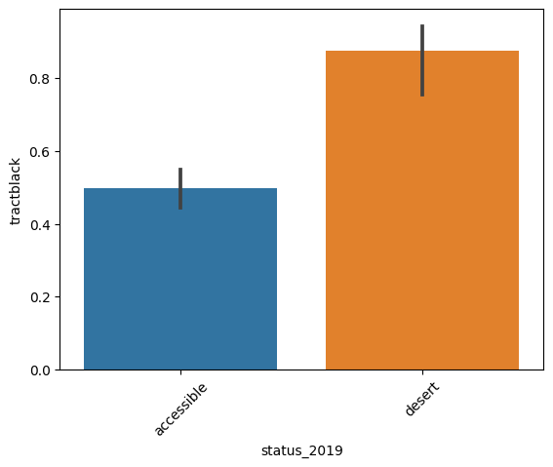
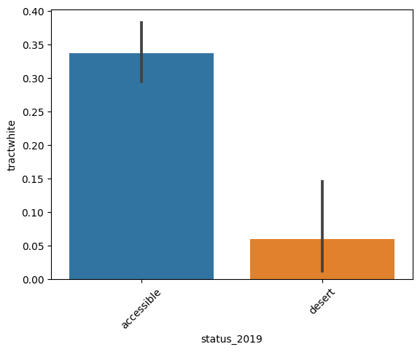
Demographics
% Black Population by Tract Status
% White Population by Tract Status
Food Accessible
Food Desert
Notes:
Using Mean values

Slide 11

Governmental Efforts to Increase Access to Food and Nutrition
SNAP Supplemental Nutrition Assistance Program
WIC Special Supplemental Nutrition Program for Women,
Infants, and Children (WIC)
SNAP Online
Introduced through the 2014 Farm Bill
Available in all States (except Hawaii and Alaska) through authorized retailers
Purchase groceries online, for delivery or pickup, using Electronic Benefit Transfer (EBT) Card
Notes:
Government efforts to improve the situation include the use of assistance programs like SNAP and WIC
SNAP and Wic are
A recent addition to the SNAP program in SNAP Online with allows for benefits to be used to purchasing groceries online
These programs aim is to help low income households and individuals to access and afford nutritional foods within these circumstances

Slide 12

Where SNAP Misses the Gap
Individual Limitations:
Staple foods predefined
Cannot use for delivery or service fees
Avg is $121 per person per month ($1.40 per meal)
Retailer Limitations:
Must meet either criteria:
Continuously stock staple foods
OR
Have over 50 % of total gross retail sales from sale of staple foods
Notes:
there are limitations or restrictions on what retailer is allowed to accept SNAP
Staple foods predefined
Not all needs covered
“Benefits cannot be used to pay for fees of any type, such as delivery, service, or convenience fees.” (USDA)
The average SNAP benefit per person in 2019 was about $121 per month, which worked out to less than $1.40 per person per meal.(cbpp.org)
Individuals:
-Staple foods v restricted items
- Fees of any type
- Monthly benefits by ind / house
- approximatel $4.00 less than 2010 ($133.79) -$3.96
Criteria set with
A - 3 units of 3 stocks (2 perishable)
B - Over 50 % of total gross retail sales are from the sale of staple food
Question of limiting access
Staple foods are explicitly defined as vegetables,fruits, dairy products, meat, poultry, fish, breads and cereals. Prepared foods, heated foods, or accessory foods are not considered to be staple foods.
On average, SNAP households received about $240 a month in fiscal years 2019 and 2020, prior to the pandemic and the TFP increase. The average SNAP benefit per person was about $121 per month, which worked out to less than $1.40 per person per meal.[11] (https://www.cbpp.org/research/food-assistance/a-quick-guide-to-snap-eligibility-and-benefits#:~:text=On%20average%2C%20SNAP%20households%20received,%241.40%20per%20person%20per%20meal. )
Restaurants aren’t allowed to participate unless they’re operating under the Restaurant Meals Program (RMP) :
Arizona, California, Illinois, Maryland, Michigan, Rhode Island, and Virginia participate
Allows elderly, disabled, and spouses of SNAP users to use benefits at restaurants within a state that has a RMP.

Slide 13

SNAP in DC
List of SNAP Online Retailers in D.C.:
ALDI
Amazon
Giant of Maryland
Safeway
2010
73 Authorized Retailers
15.3% Poverty Rate
2019
58 Authorized Retailers
12.3% Poverty Rate
There was a decrease poverty rate for D.C. overall, but that isn’t reflective of the poverty rates within D.C. food deserts
Notes:
SNAP in DC:
K-ASK: start with list of snap online retailers that allow for snap benefits, and then talk about the reduction in available stores between 2010 and 2019, likely because of consolidation.

Slide 14

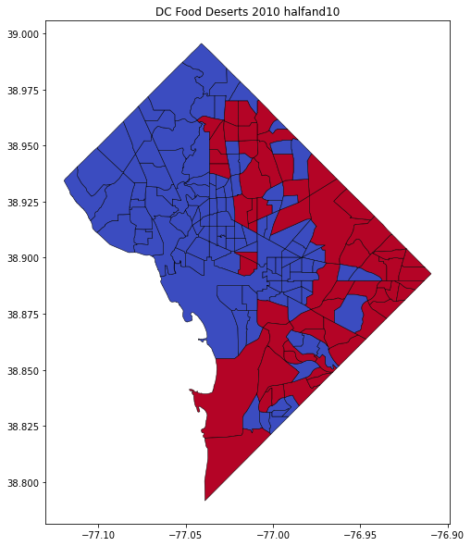
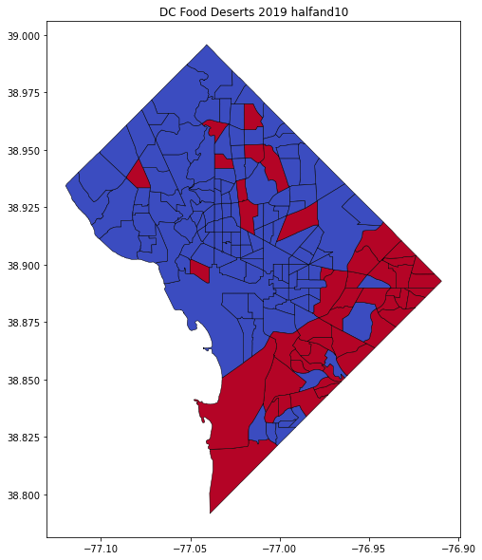
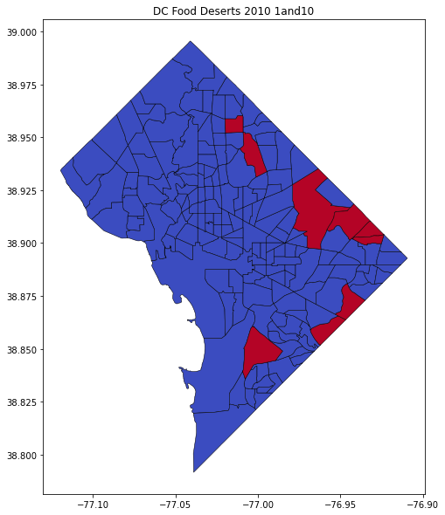
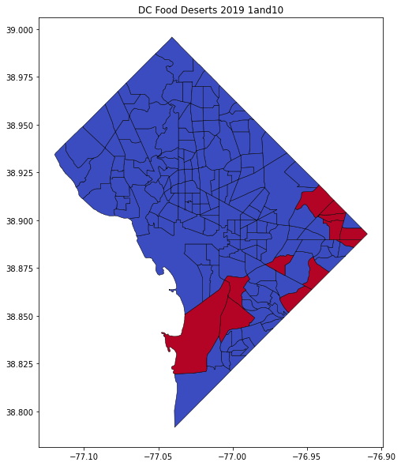
Efforts to reduce food deserts over the past decade
$220 million in public funds, $1 billion in private investment
Funded 1,000+ retailers serving food deserts in 35 states
NIH “The Changing Landscape of Food Deserts” (2019)
Half-Mile Food Desert
1-Mile Food Desert
2010
2019
2010
2019
7% decrease
1.7% increase
Notes:
Say this: Along with attempts to improve nutrition, the government has also poured millions into the problem of food deserts. More than $220 million in public funds were put toward reducing food deserts, which also brought in more than $1 billion in private investment to fund nearly 1,000 retailers serving food deserts in 35 states. As with the SNAP program, this also ran into some limitations, which K will talk about now.

Slide 15

Differences between 2010 and 2019
 | US Overall |  | DC
 | half-mile | 1-mile | half-mile | 1-mile
2010 | 27.2% (19k of 72k) | 12.3% (9k of 72k) | 34.0% (61 of 179) | 5.0% (9 of 179)
2019 | 27.9% (20k of 72k) | 12.8% (9.2k of 72k) | 27.0% (49 of 179) | 6.7% (12 of 179)
Difference | (▲ 0.7%) | (▲ 0.5%) | (▼ 7%) | (▲ 1.7%)
Despite efforts, attracting for-profit grocers to food deserts may not be the best way to improve food access
Notes:
Despite efforts, food deserts slightly increased in the US overall between 2010 and 2019. In DC’s case, the food deserts were shuffled around a bit, and a decrease was seen in half-mile access, but 1-mile access got worse. As a reminder, the criteria to become a food desert includes a change in poverty rate or a change in market access. From our analysis, we saw that the six tracts of the twelve that became 1-mile food deserts did not have a change in poverty between 2010 and 2019, which suggests that grocers actually moved away from those areas despite the heavy investment efforts. And in conclusion…

Slide 16

Conclusion: Missing the Point
Despite investment, food deserts have largely not been improved
Further consolidation of small grocers means fewer stores farther away
Even with increased access to stores, low-income residents may not have the funds to purchase healthy foods due to SNAP limitations
Food deserts as a measurement may become obsolete due to grocery delivery, but that may not change nutrition outcomes or food insecurity
Notes:
Our analysis suggests that despite over $1B put towards incentivizing businesses to come to these areas, food deserts are still prevalent. Large corporations have continued to consolidate resulting in fewer and fewer locations for people to access. And even if residents had increased access to supermarkets and grocery stores, they may not have the funds to purchase healthy foods, since SNAP benefits provide on average $1.40 per person per meal.
Additionally, the way food deserts are defined may soon make the measure obsolete due to the prevalence of delivery options, but due to the cost constraints and that SNAP cannot pay for delivery fees, that increased access may still not change nutrition outcomes or food insecurity overall.

Slide 17


Future recommendations
Increasing SNAP benefits per person
Funding more nonprofit grocers
Subsidizing prices of healthy foods for low-income areas
“In the end, it is how much money we have, not how much access we have to the supermarket, that determines our food choices.”
H. Gilligan, Slate
Notes:
For future efforts and policy improvements, we recommend [read]. For further research, we recommend shifting the focus away from food access and more toward food affordability. As this quote says, [read]

Slide 18
Thank You

Slide 19

Questions?

Slide 20

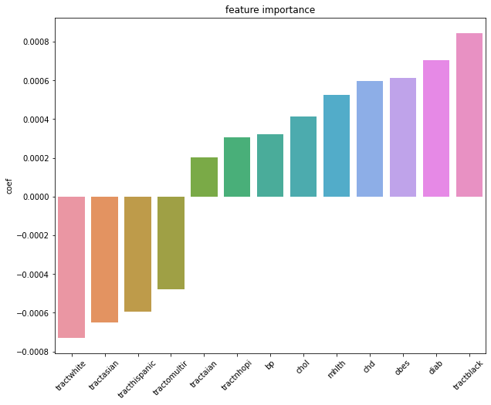
Supplemental slide - simple Logistic Regression Model

Slide 21

Connect to Sources
Definitions of Food Security.
'We didn't have much, and you took what was left'
USDA ERS - Go to the Atlas
History, Background, and Goals of the Supplemental Nutrition Assistance Program.
Special Supplemental Nutrition Program for Women, Infants, and Children (WIC)
HR2642 - 113th Congress (2013-2014): Agricultural Act of 2014
Stores Accepting SNAP Online | Food and Nutrition Service
What Can SNAP Buy? | Food and Nutrition Service
Online grocery delivery is about to kill food deserts
Stores Accepting SNAP Online | Food and Nutrition Service
PL 88-525 - Food and Nutrition Act of 2008
Restaurant Meals Program | Food and Nutrition Service
Healthy Food Financing Initiative - The State of Childhood Obesity
The changing landscape of food deserts - PMC
The prevalence of food insecurity in 2020 is unchanged from 2019
The Real Farm Subsidy Scandal? USDA's Legacy of Racial Discrimination. | Environmental Working Group
https://fns-prod.azureedge.us/sites/default/files/resource-files/SNAPsummary-5.pdf
https://www.census.gov/data-tools/demo/saipe/#/?map_geoSelector=aa_s&s_state=11&s_year=2020,2019&map_yearSelector=2019

Slide 22
Data Sources
Food Access Research Atlas - USDA https://www.ers.usda.gov/data-products/food-access-research-atlas/download-the-data/
Social Vulnerability Index - CDC https://www.atsdr.cdc.gov/placeandhealth/svi/at-a-glance_svi.html
PLACES: Local Data for Better Health - CDC https://chronicdata.cdc.gov/500-Cities-Places/500-Cities-Census-Tract-level-Data-GIS-Friendly-Fo/k86t-wghb
SNAP Online - USDA https://www.ers.usda.gov/amber-waves/2021/july/online-supplemental-nutrition-assistance-program-snap-purchasing-grew-substantially-in-2020/

Slide 23
Definitions
Low-income neighborhoods
The criteria for identifying a census tract as low income are from the Department of Treasury’s New Markets Tax Credit (NMTC) program. This program defines a low-income census tract as any tract where:
The tract’s poverty rate is 20 percent or greater; or
The tract’s median family income is less than or equal to 80 percent of the State-wide median family income; or
The tract is in a metropolitan area and has a median family income less than or equal to 80 percent of the metropolitan area's median family income.
https://www.ers.usda.gov/data-products/food-access-research-atlas/documentation/

